Slide 1
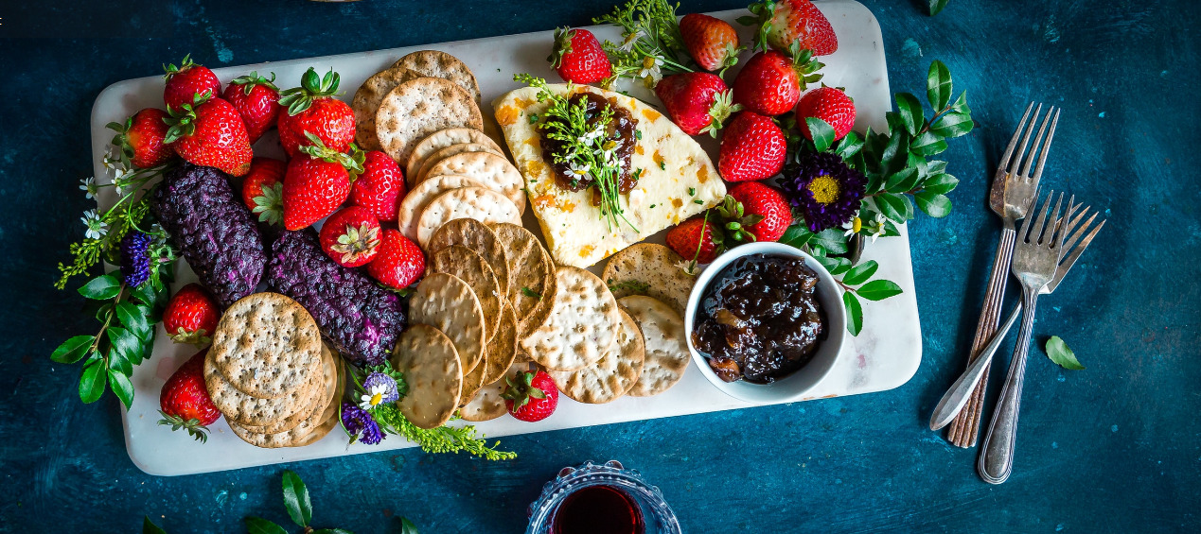
Islington Canteen Project
Presented By
Akshyata Singh Dangol
Deepika Karki
Pratikshya Rijal
Hem Bahadur Gurung

Slide 2

Problem statement
Islington canteen sales is declining during summer

Slide 3

Project Goal
To increase College Canteen Revenue

Slide 4

Objective
To increase Canteen revenue by Rs.5000 daily
To reach number of customer 150 daily
To increase gross profit by 35%

Slide 5

Strategy
To organize events, tournaments, Carnival and food festivals
To do survey about the choice and preference of customers
To add summer drinks and foods on menu after survey
Marketing and advertisement through social media, website, blogs, Noticeboard, banner and posters
To provide homely and canteen environment for students doing assignments

Slide 6

Feasiable solution
To organize events, tournaments, Carnival and food festivals
To add summer drinks and foods on menu after survey

Slide 7



Software Tools

Slide 8
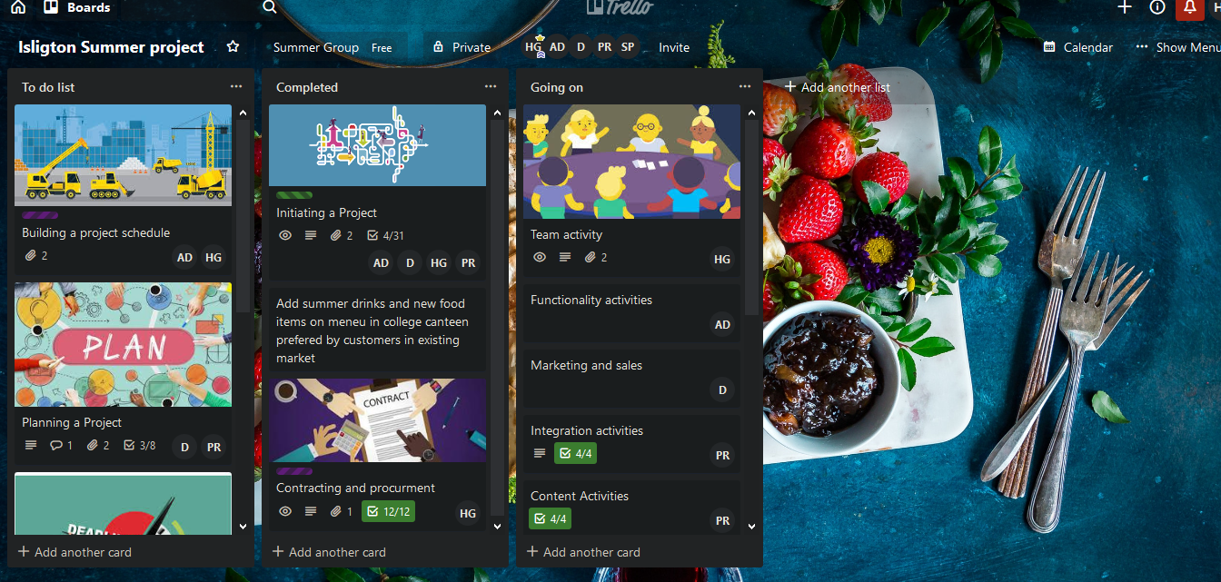
Trello Workshop

Slide 9
Farmers
Customer
Staff
Management Team
Bank
Fruit shop
Restaurants
Stakeholders
vender
Fruit shops
students

Slide 10
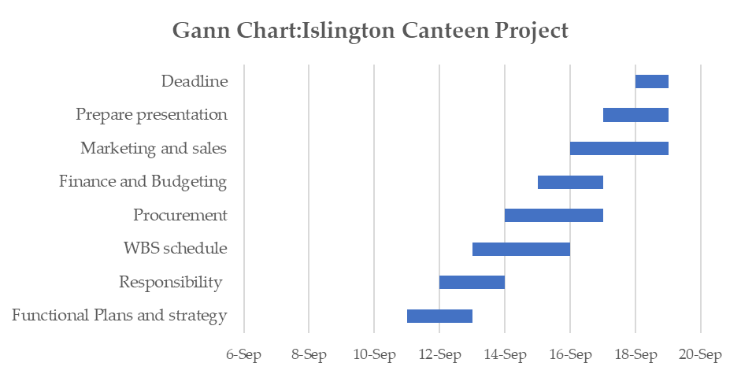

Slide 11



















WBS : Islington Canteen Revenue

Slide 12
Responsibility Matrix

Slide 13
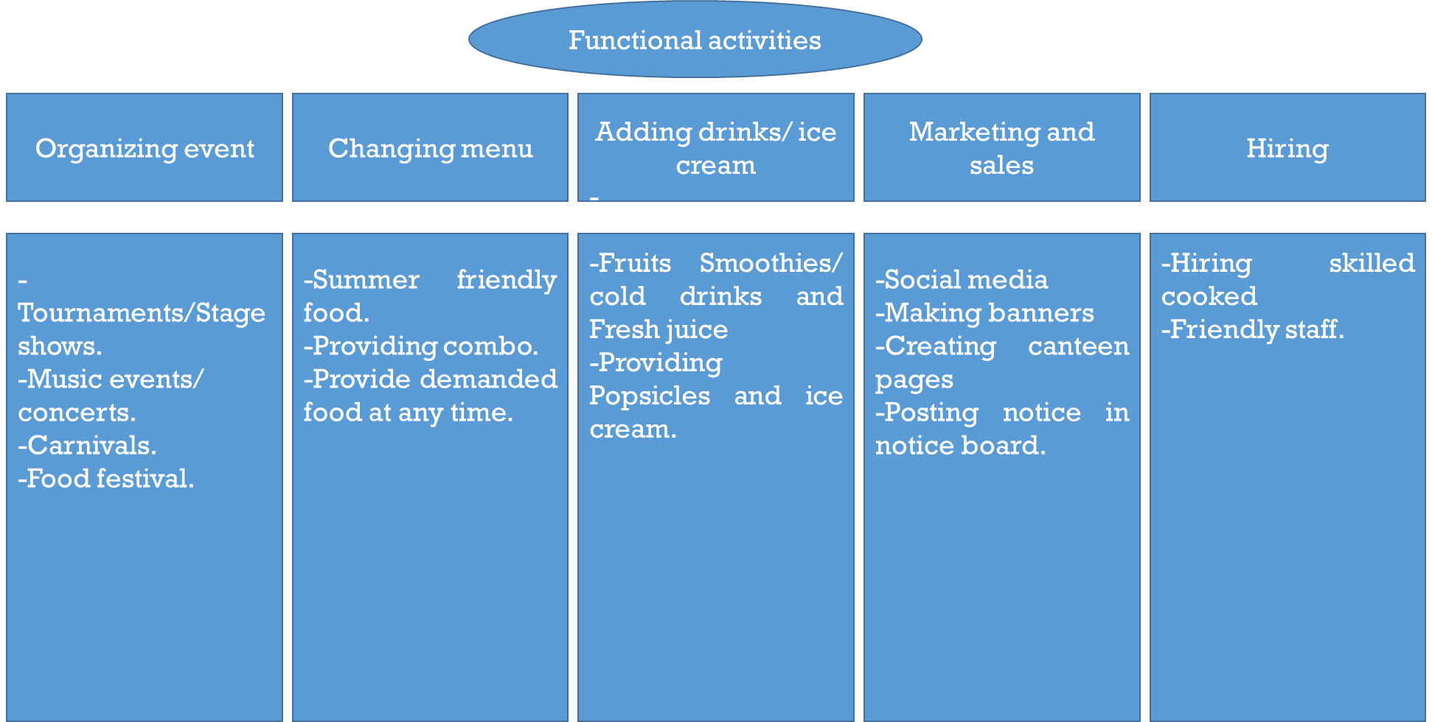
Functional Activities

Slide 14
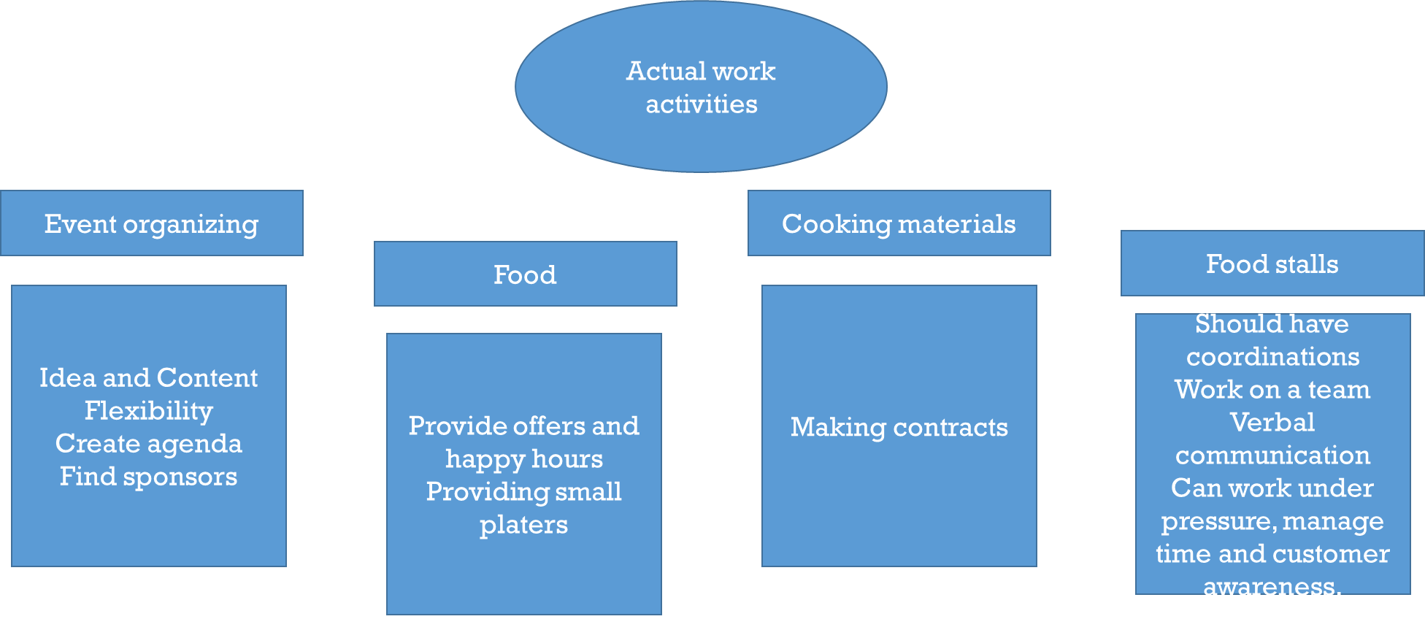
Actual Work Activities

Slide 15

Marketing
Survey and Market research about the preference and choice of customers
Sampling and demos of fruit juice and foods
Change of Menu to attract various customers(demo)
Ice cream,Smoothies,Burger,Toast,Chips Chilly etc..
Advertising through College social media
Email marketing,Blogger,instagarm,facebook, text marketing
Banner ads near the college for promotion of events
Noticeboard, word of mouth
Offers and combos for the customers
Organizing inter college events
Futsal,basketball,Carnival,singing,dancing

Slide 16

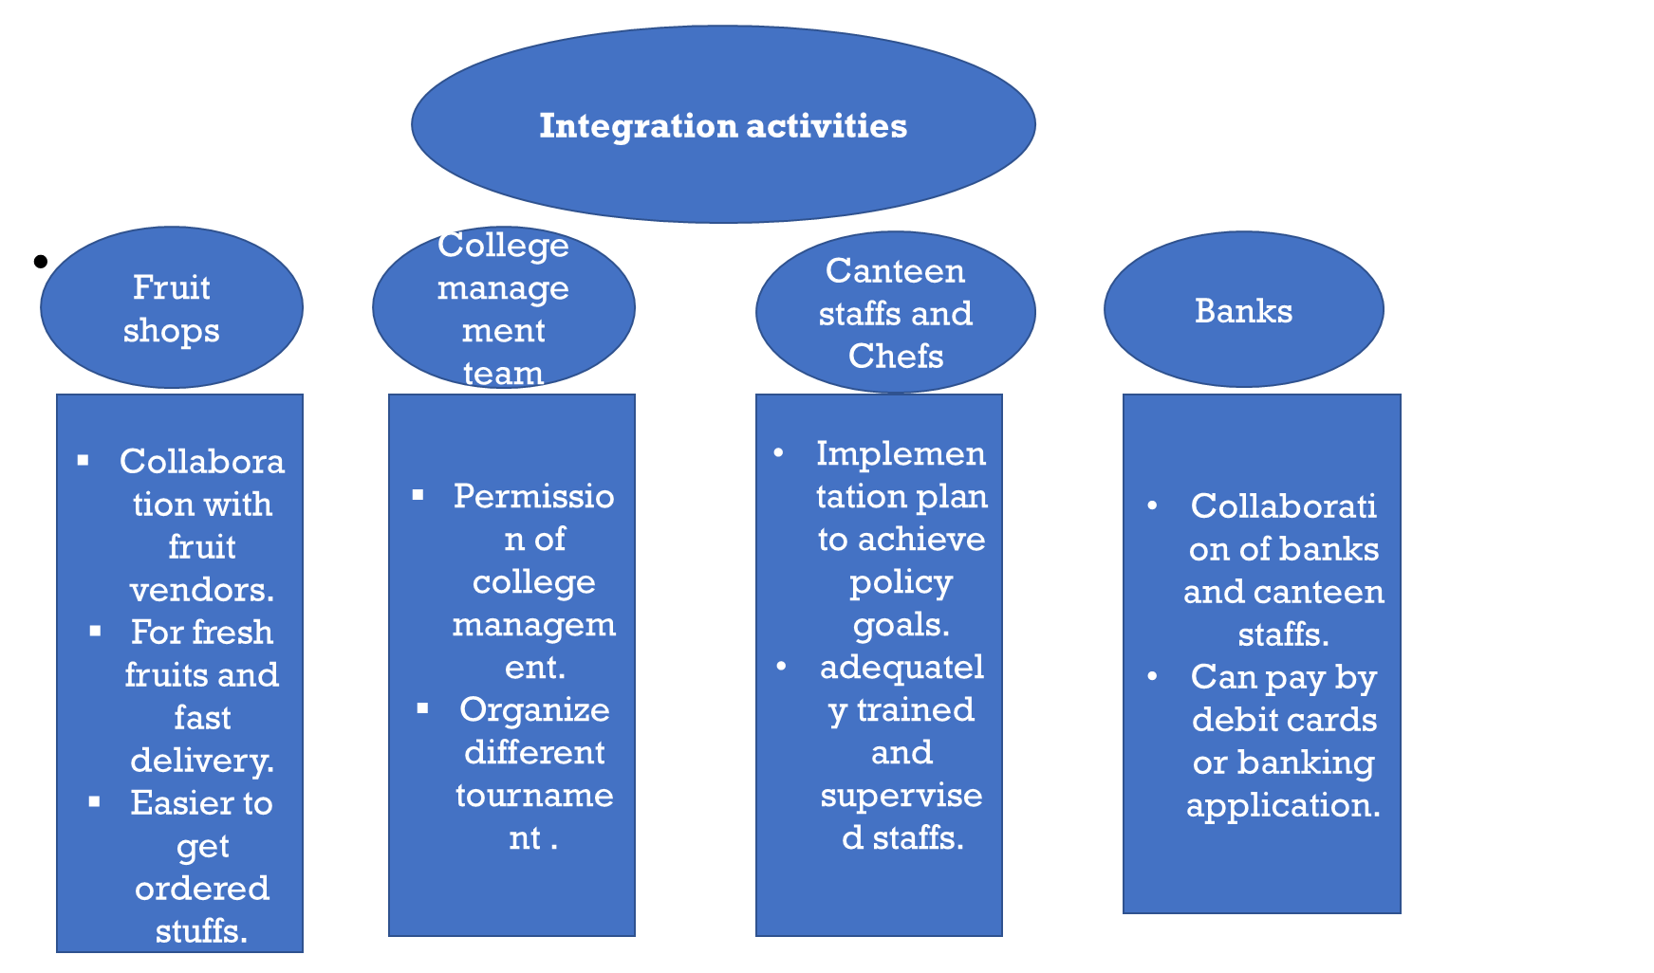
Integration

Slide 17
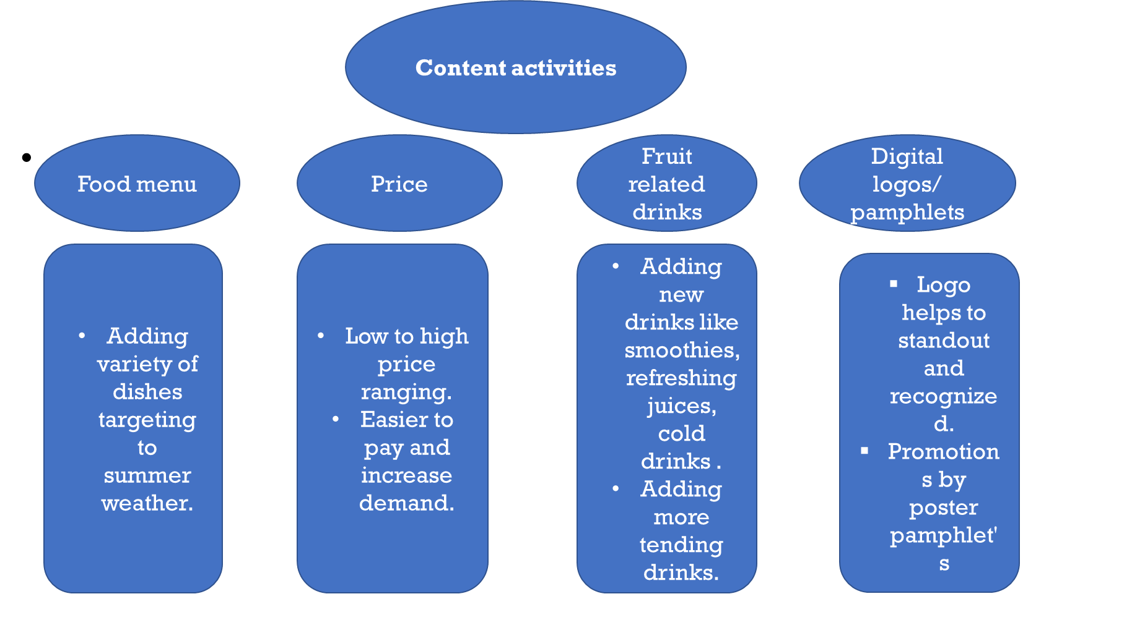

Content

Slide 18

Design
Presentation of the dish
Drinks to presented in a fancy and unique way
Unique and eye-catching ads
Time schedule of games and sports
space outlet and design
table chair and other furniture Management

Slide 19




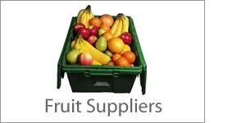


Contract and Procurment

Slide 20
Canteen Summer Purchase(Rs.)
Sales summer Canteen(Rs.)

Slide 21
Daily sales Projection
Note: Sales target 150 customers daily

Slide 22
Finance
Profit and Loss statement
3 quarterly 2019 projection
Daily sales projected Rs.15340

Slide 23
Islington Summer
Balance Sheet
Third Quarter 2019 Projection

Slide 24
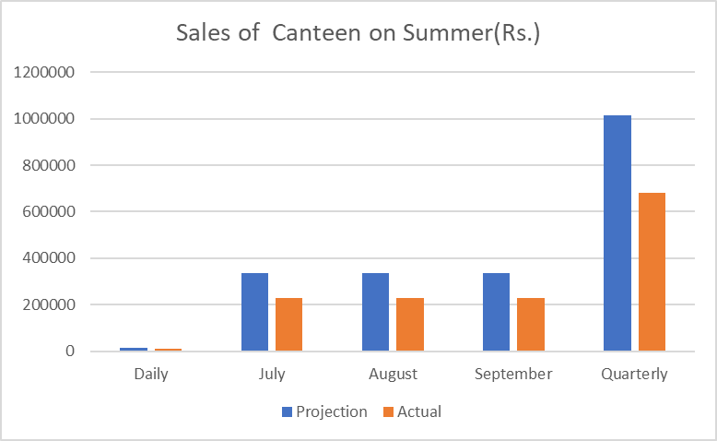
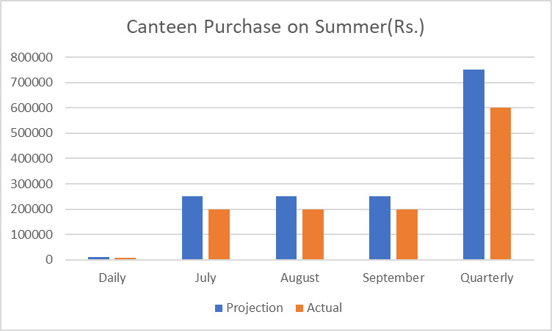
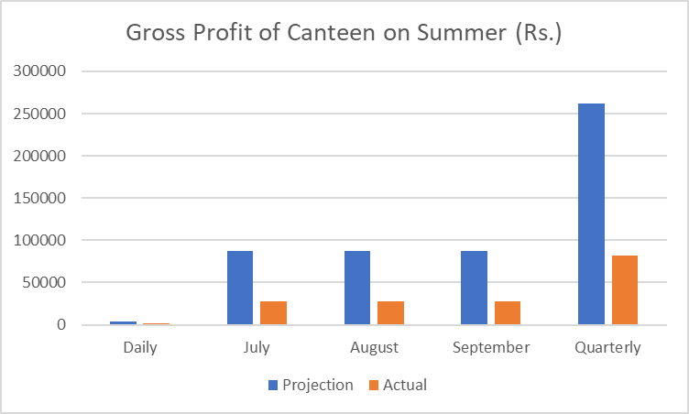
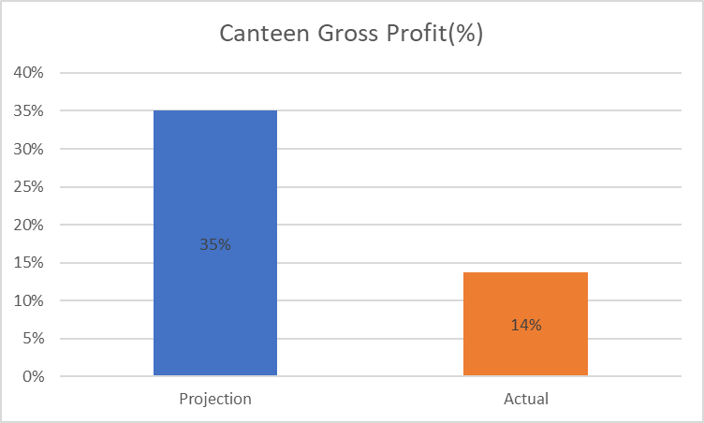

Slide 25


Slide 26


